Slide 1
5G Coverage and Performance

Slide 2



From 4G to 5G Transition
Today – 4G Access
Device attaches to LTE/4G radio and Evolved Packet Core (EPC)
Early 5G – Non-Standalone (NSA)
Device attaches to 5G-NR, which routes either via 4G Base Station to EPC, or direct to EPC
4G acts as control plane
5G Standalone (SA)
Device attaches to 5G-NR and 5G Core Network.
EPC
4G
UE
5G-CN
5G

Slide 3
5G NSA field trials and testing
5G Non-Standalone (NSA) is being largely adopted for the rollout of 5G networks
It is key to investigate how 5G NSA performs in the wild
Large-scale measurement campaign on 5G NSA deployments in Rome, Italy
Empirical analysis of the 5G coverage and performance

Slide 4
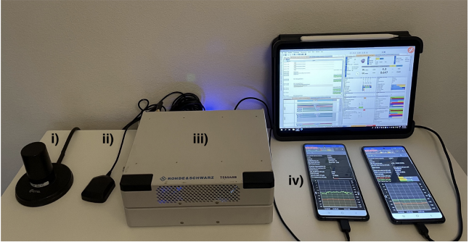
Measurement Setup and Campaign
Four MNOs (Op1-Op4) offering 4G and 5G NSA connectivity in Rome, Italy
Measurements period: 9 months (March 2023 - November 2023)
Campaign organized in “sub-campaigns”: different days, different times of the day and different locations
Three mobility scenarios:
Indoor Static (IS): measurements indoor
Outdoor Walking (OW): measurements while walking outdoor
Outdoor Driving (OD): measurements while driving a car
i. RF antenna
ii. GPS antenna
iii. R&S TSMA6 scanner
iv. two 5G capable UEs
For network analysis, troubleshooting, visualization, and data exporting, we used the R&S ROMES software
Notes:
Outdoor Walking (OW): measurements while walking (average speed of 3.53 km/h, with stops due to traffic lights)
Outdoor Driving (OD): measurements performed while driving a car (average speed of 19.4 km/h, with stops due to traffic lights)

Slide 5
Passive Measurements
TSMA6 detects and decodes downlink control information
Measurements 4G and 5G at each location
Dataset features:
Spatial (Latitude and Longitude) and temporal (Date, Time) information
Carrier frequency identifiers
Signal strength/quality indicators
Notes:
4G: measurements on the Reference Signal (RS) sent by 4G PCIs
5G: measurements on the SSS, sent by 5G PCIs in the SSBs:
SS Reference Signal Received Power (SS-RSRP)
SS Reference Signal Received Quality (SS-RSRQ)
SS Signal to Interference and Noise Ratio (SS-SINR)

Slide 6
Active Measurements
Android application Qualipoc running on two Samsung S20 5G-capable devices
Throughput Test: Speedtest by Ookla jointly with R&S Qualipoc to measure the end-to-end downlink (DL) and uplink (UL) throughput
throughput (donwlink, uplink)
Latency/Reliability Test: Qualipoc interactivity test with i. eGaming real-time traffic pattern and ii. AR/VR cloud gaming traffic pattern.
RTT
interactivity score, i.e., combination of Round Trip Time (RTT), Packet Delay Variation (PDV), Packet Error Rate)
Notes:
4G: measurements on the Reference Signal (RS) sent by 4G PCIs
5G: measurements on the SSS, sent by 5G PCIs in the SSBs:
SS Reference Signal Received Power (SS-RSRP)
SS Reference Signal Received Quality (SS-RSRQ)
SS Signal to Interference and Noise Ratio (SS-SINR)

Slide 7
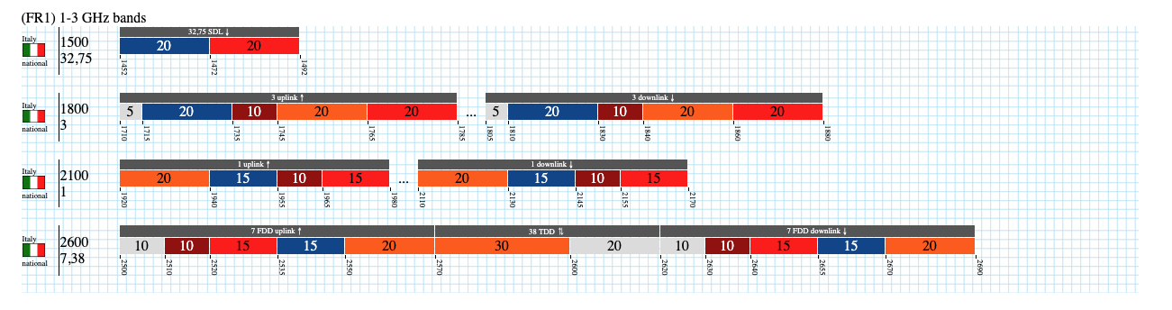

Carrier frequency identifiers
https://www.spectrummonitoring.com/frequencies.php?market=I
Notes:
4G: measurements on the Reference Signal (RS) sent by 4G PCIs
5G: measurements on the SSS, sent by 5G PCIs in the SSBs:
SS Reference Signal Received Power (SS-RSRP)
SS Reference Signal Received Quality (SS-RSRQ)
SS Signal to Interference and Noise Ratio (SS-SINR)

Slide 8
Signal Indicators
(SS-)RSRP: Indicates the average power of the received reference signal spread over the full bandwidth. It is affected by distance, nearby buildings, walls, weather conditions, etc.
Range (in 4G): -140dBm (bad) to -44dBm (good)
(SS-)RSRQ: Indicates the quality of the received reference signal. It is defined as RSRQ = N x RSRP / RSSI, where N is the number of Physical Resource Blocks.
Range (in 4G): -19.5dB (bad) to -3dB (good)
(SS-)SINR: Indicates the signal-to-noise ratio of the received signal. In other words, it measures the ratio of the desired signal power to the sum of the power of the interfering signals and can be used to measure the quality of the connection
Range (in 4G): -20dB (bad) to 20dB (good)
These ranges slightly differ for 5G.

Slide 9
Behind the Doors: 4G and 5G Datasets

Slide 10
Data Sources
Passive dataset:
Multiple .csv files (one for each sub-campaign)
The name of the file can be used for grouping data under the same location/area
Reports information such as Date/Time, signal strength for each detected neighboring cell
Other available information such as Frequency/Band and mobility scenario (IS, OW, OD) are also available
Structure of the dataset:
Time series - consists of ‘frequency scans’
`batch` of samples sharing features such as Date, Time, Latitude, Longitude, and Frequency.
Active dataset:
Multiple .csv files (one for each sub-campaign)
The name of the file can be used for grouping data under the same location/area
Indicators related to the radio and physical layers, as well as QoS and QoE indicators.
Structure of the dataset:
Time series but event-based — the dataset was updated at millisecond-level granularity
Row records with ’?’ represent unaltered values.
Important: You can use the file name to isolate both passive and active data from a particular sub-campaign

Slide 11
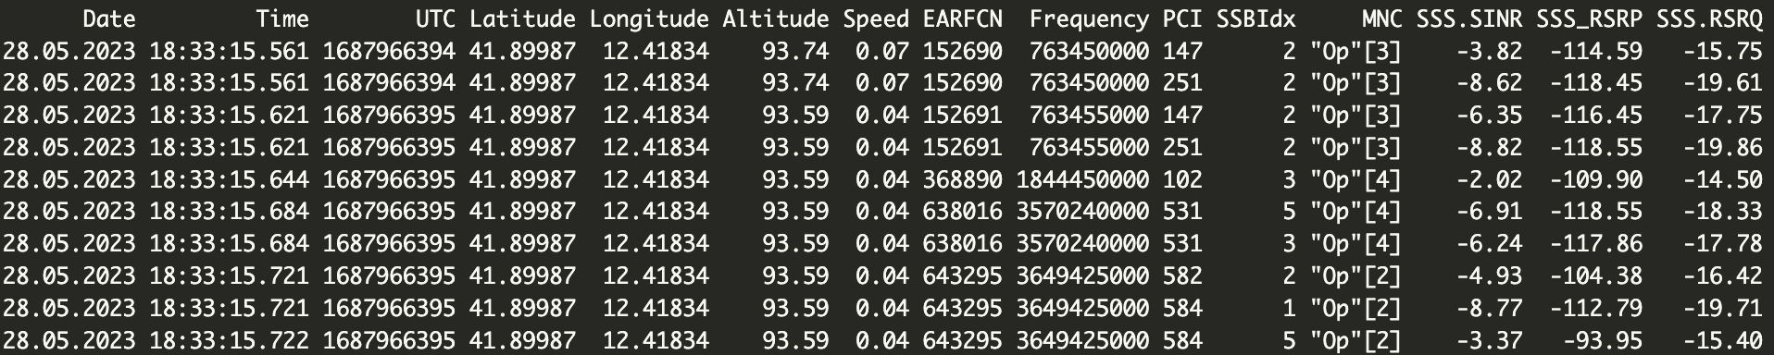
Example (5G) - Passive dataset

Slide 12
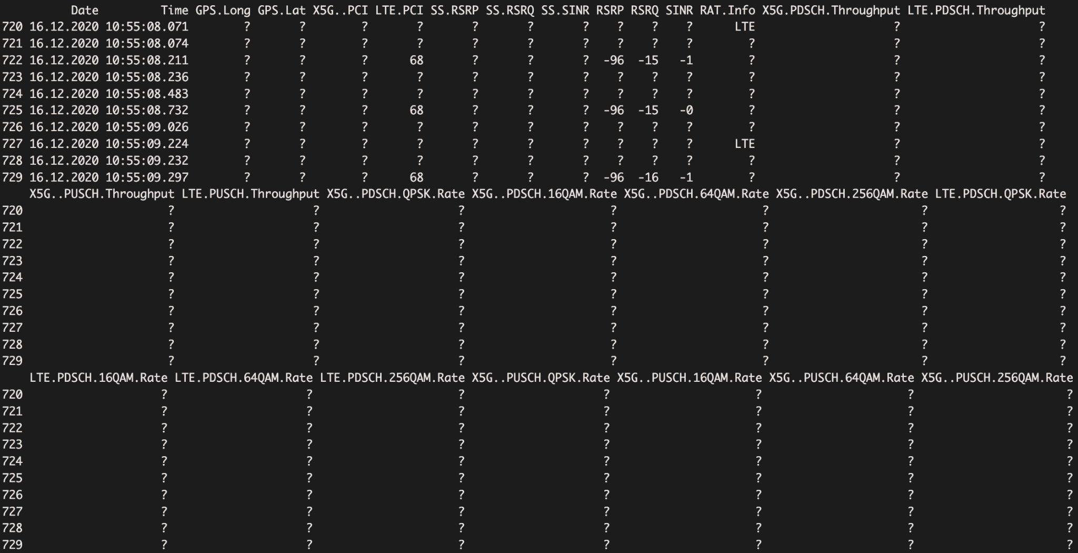
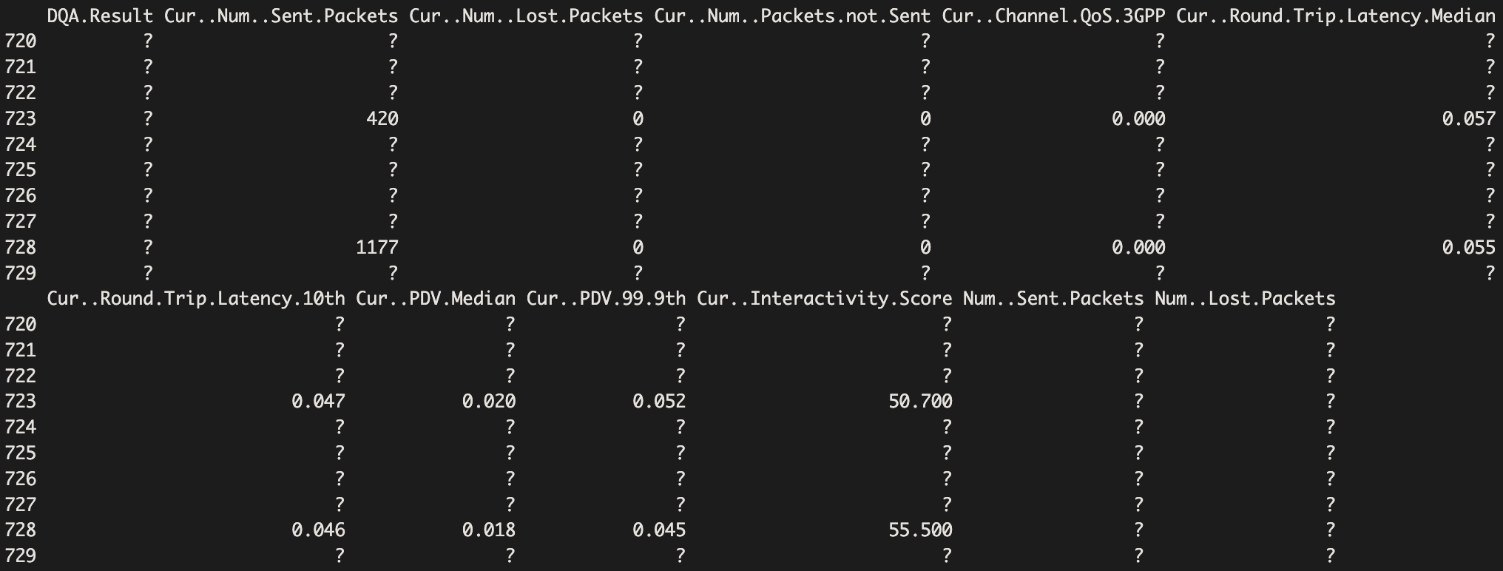
Example - Active

Slide 13
Post-Processing challenges
Cleaning: Remove metadata and measurement configuration details from raw data files
These were exports from a measurement software tool (ROMES)
Missing Data: How to handle?
e.g., MNC missing - Action: insert it by using other features (such as Frequency)
e.g., GPS missing - Action: if indoor campaign, insert it manually
Mutate Data: Add features useful for the analysis
e.g., location, mobility scenario, folder structure (for future segmentation), etc.
Invalid Data: Requires domain knowledge
Look for outliers and extreme values
Determine either extreme (of interest) behavior or measurement error

Slide 14
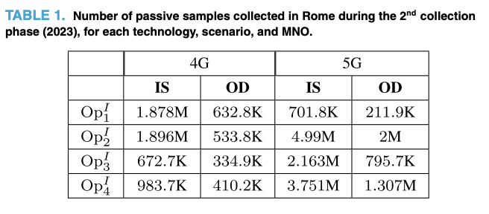
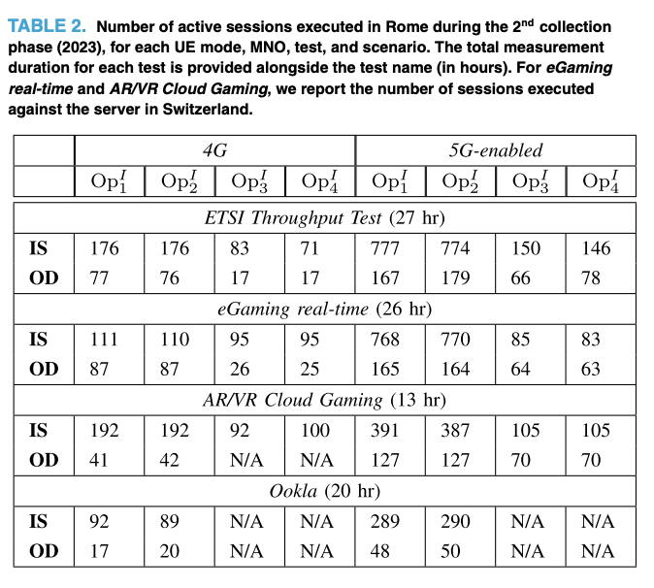
A few numbers
Additional information regarding the dataset available in our paper: ‘The Chronicles of 5G Non-Standalone: An Empirical Analysis of Performance and Service Evolution’ available here: https://ieeexplore.ieee.org/abstract/document/10753472

Slide 15
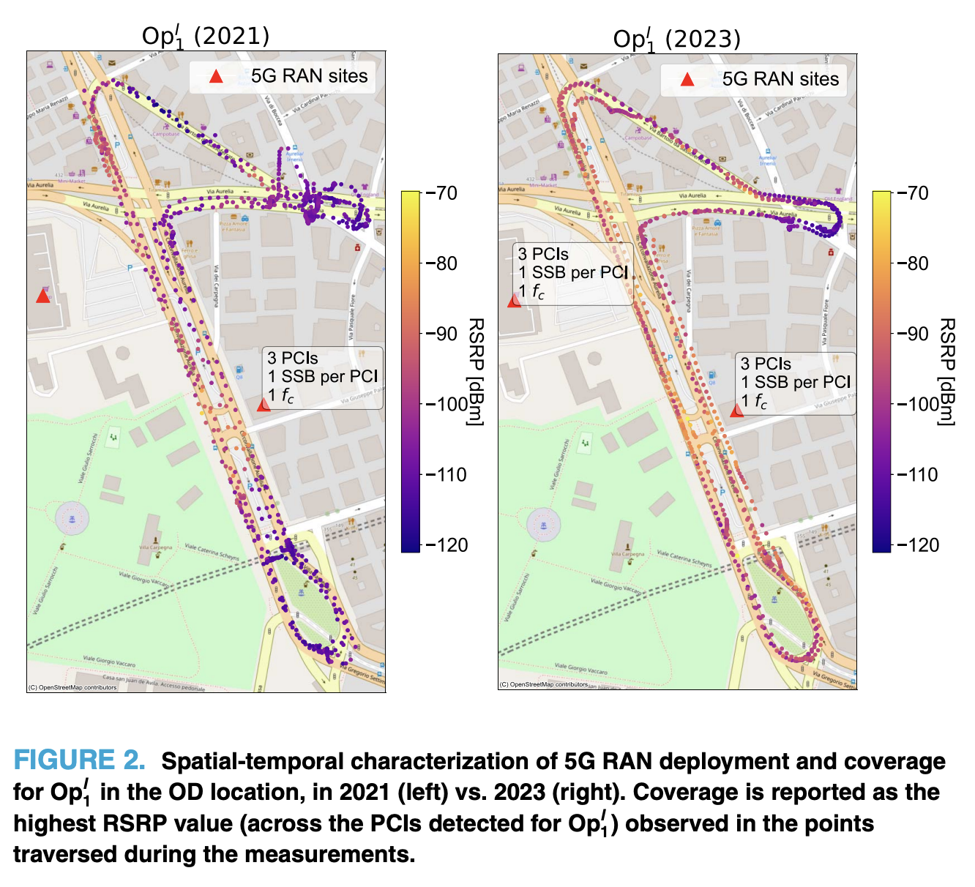
5G Deployment map (2021)

Slide 16
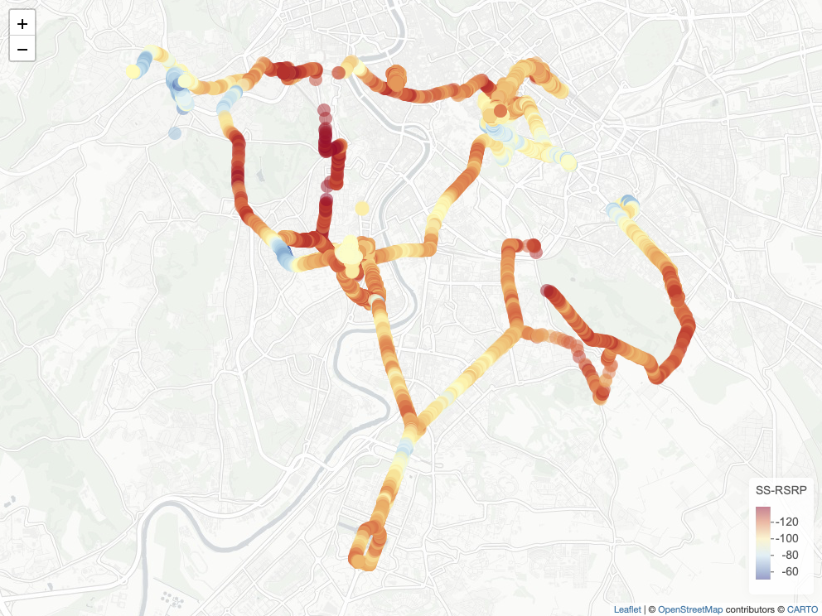
5G Coverage map (2021)
Highest SS-RSRP [dBm] measured across the 5G PCIs of Op1 detected at the locations traversed during OW and OD sub-campaigns.

Slide 17
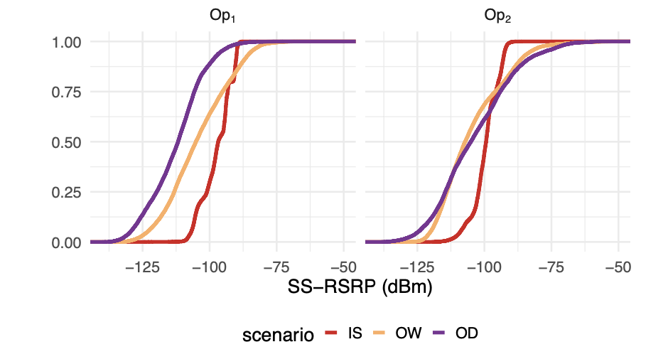
5G Coverage (2021)
Distribution of 5G SS-RSRP [dBm] (in an ecdf format), for 𝑂𝑝1 and 𝑂𝑝2 and grouped by scenario.

Slide 18
Significance Tests
Kruskal-Wallis (non-parametric): Determine statistical significance between the means of more than two independent groups Assumptions:
No assumptions
Null Hypothesis: The means across all groups are equal
Alternative Hypothesis: At least one group mean is different from the rest
if p-value is less than a significance level (e.g., 0.05), we can reject the null hypothesis
Dunn’s Test (non-parametric): If Kruskal-Wallis shows statistical significance, conduct Dunn’s test to determine which groups are different (test each combination of groups)

Slide 19
Operator and Technology comparison
Technology | IS | IW | OW | OD
4G | 0.2906 | 0.0274 * | 0.2480 | 0.3581
5G | 0.1594 | 0.00033 *** | 0.1152 | 0.1439
Operators have significant differences especially for Indoor scenarios.
Operator comparison
Operator | IS | IW | OW | OD
1 | 0.0021 ** | 2.3e-09 *** | 0.0117 * | 1e-05 ***
2 | 0.0133 * | 1e-06 *** | 0.00078 *** | 1e-05 ***
Different technologies have significant differences for both operators.
Technology comparison

Slide 20
Assignment

Slide 21
How to access the dataset
Download the dataset here: https://zenodo.org/records/14073311 (active measurements) https://zenodo.org/records/17208871 (passive measurements)
Important complementary material:
Article: G. Caso et al., "The Chronicles of 5G Non-Standalone: An Empirical Analysis of Performance and Service Evolution," IEEE Open Journal of the Communications Society(IEEE OJ-COMS), pp. 1-21, 2024 (https://ieeexplore.ieee.org/document/10753472)
Check the description file for a complete list of all available features
Description of the features https://zenodo.org/records/8224890/files/description.pdf?download=1

Slide 22
What to evaluate
Coverage and performance analysis
Given a selected number of different (sub-)campaigns, compare the coverage and/or performance of different operators (further dissect per frequency band)
Given two or more sub-campaigns at the same location (e.g., repetitions of indoor/outdoor campaigns), show how the coverage and/or performance changes over time.
Given a single operator, compare the coverage and/or performance across different locations or scenarios. HINT: Particularly interesting for OD campaigns
Incorporate 2 of the 3 items above in your assignment
Make sure to carry out statistically significance tests among different groups!

Slide 23
Contact Points
ozgua@ifi.uio.no
konstako@ifi.uio.no

